Slide 1
BASIC PYTHON PROBLEM
NAME:ROHIT GEDAM
AWS BARCH 19/RESTART.

Slide 2
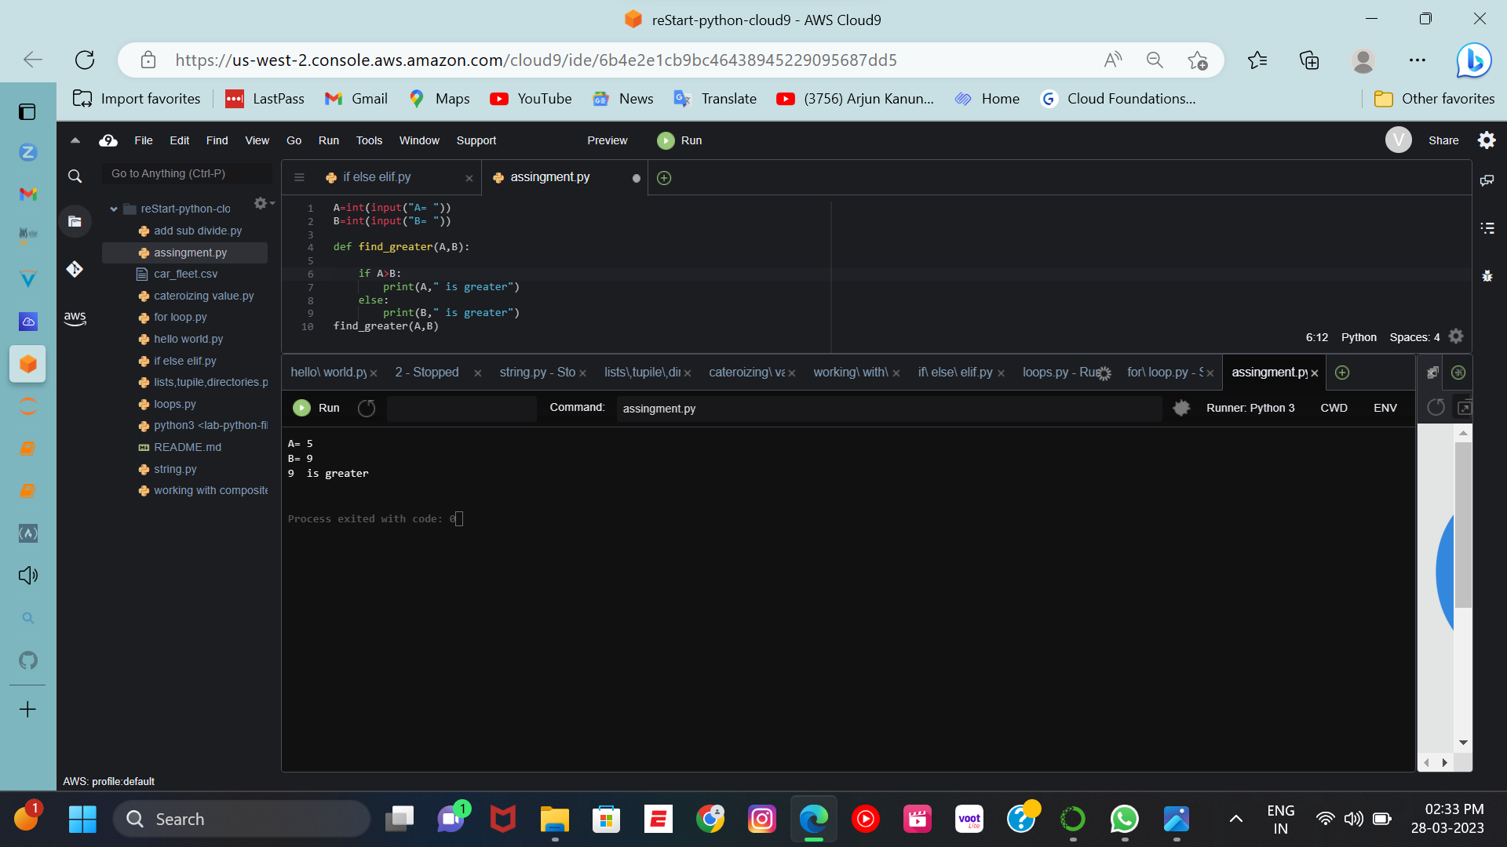
1.Finding the greater no.

Slide 3
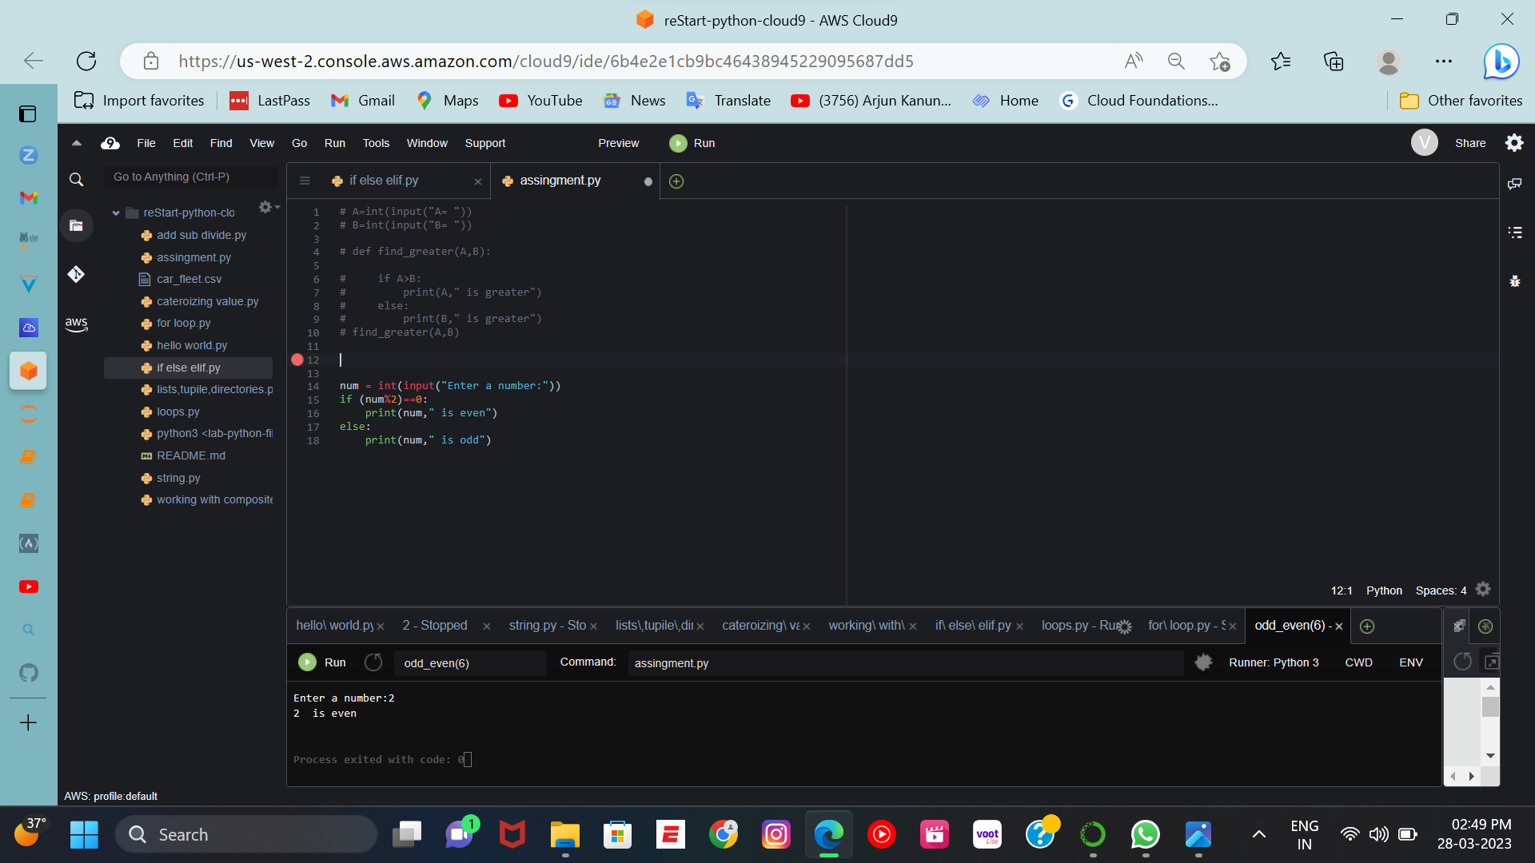
2.Find the no. is odd , even

Slide 4
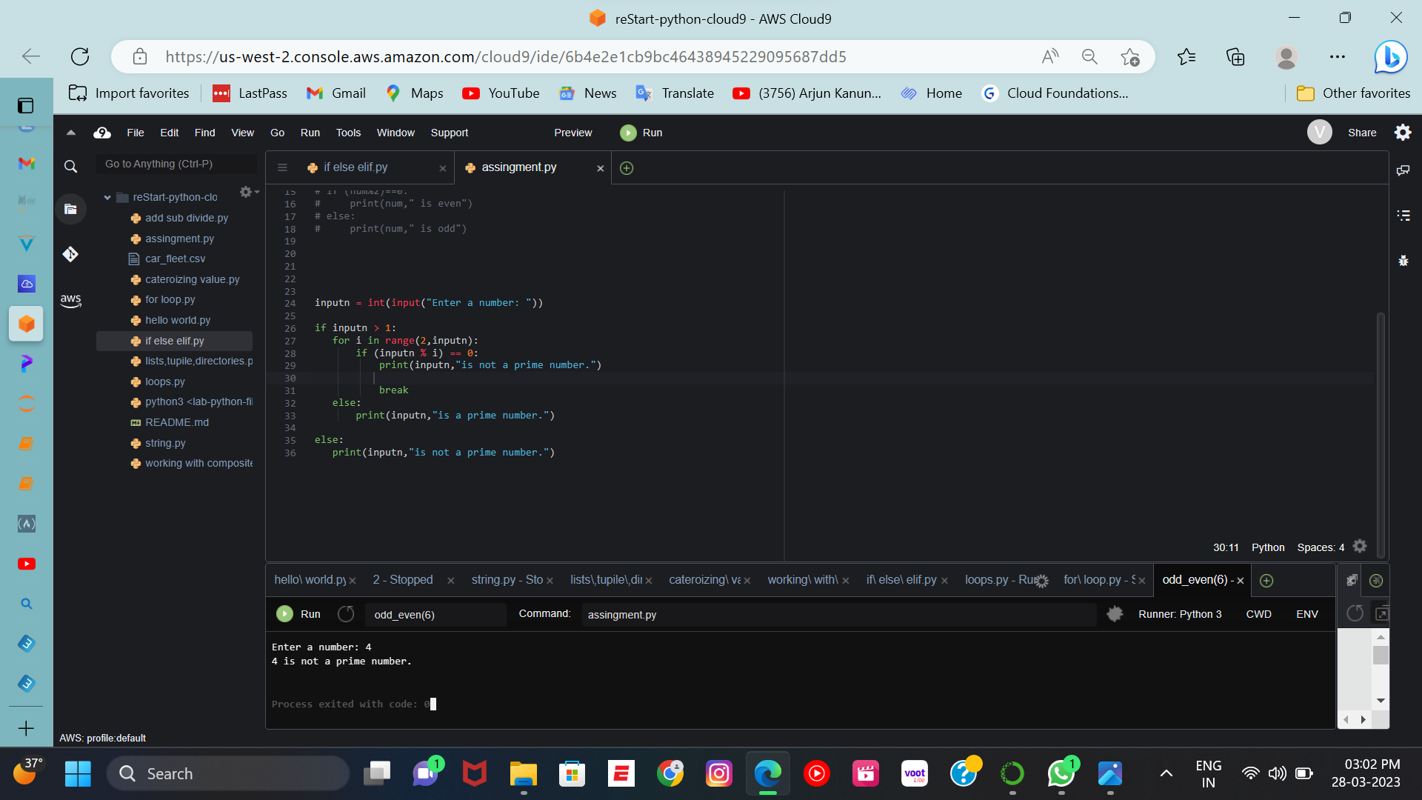
3.Find the prime NO.

Slide 5

4.Factorial of No.

Slide 6
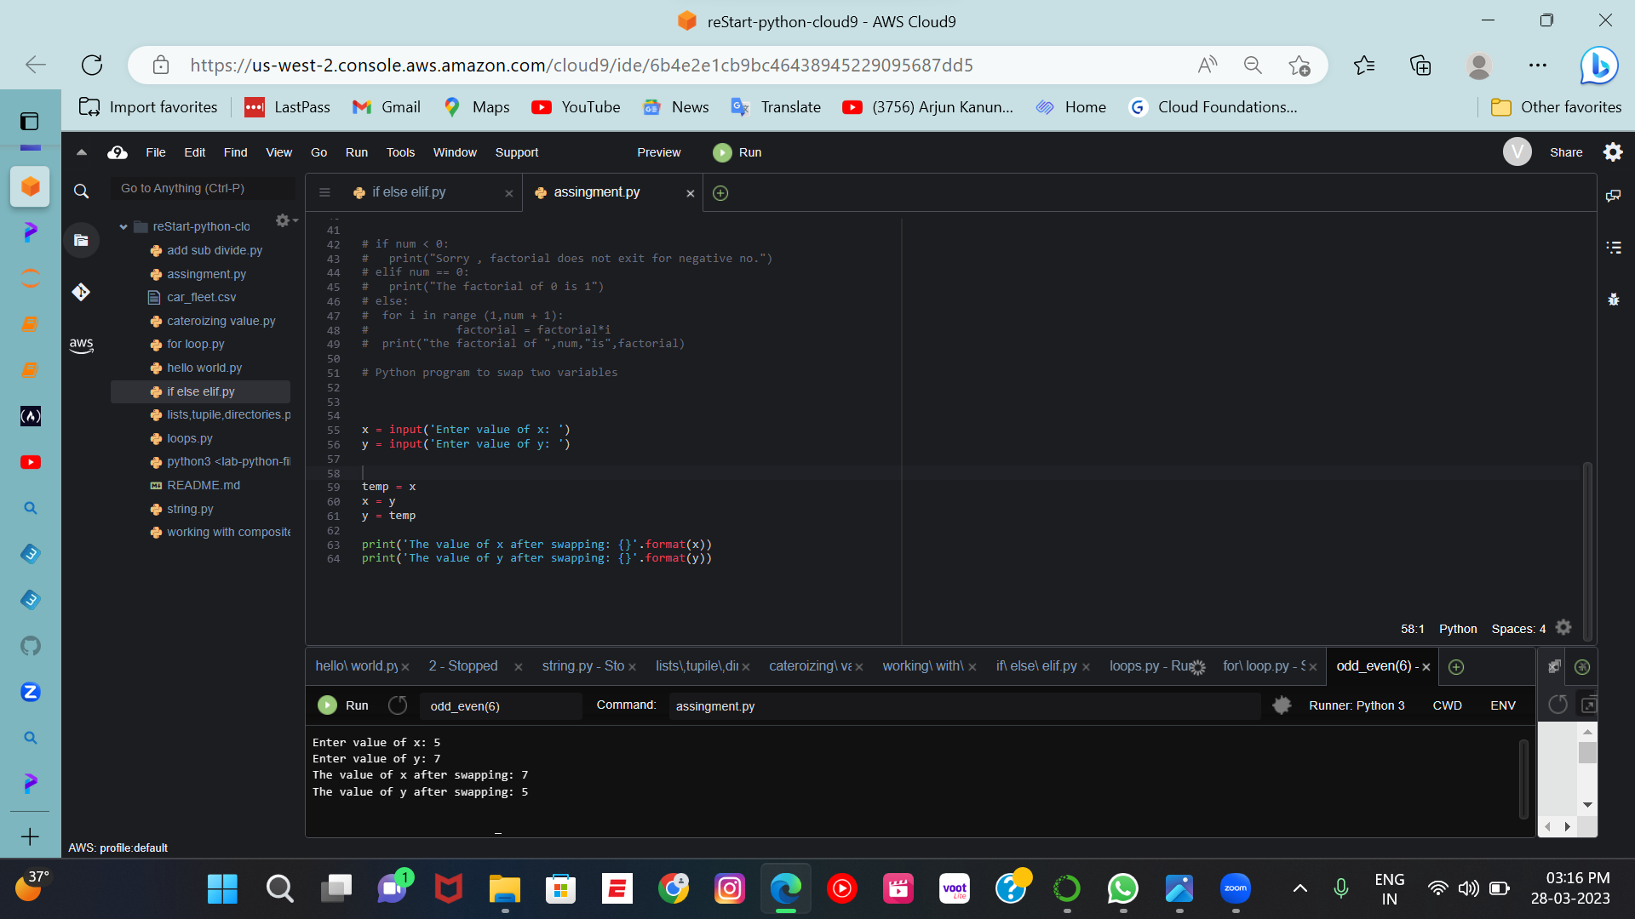
5.Swaping of No.

Slide 7
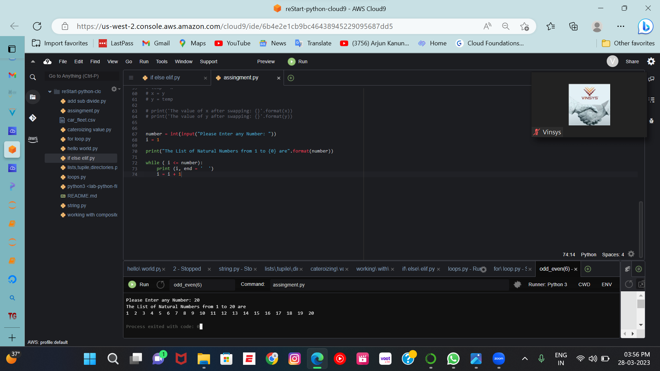
6.Number from 1 to n

Slide 8
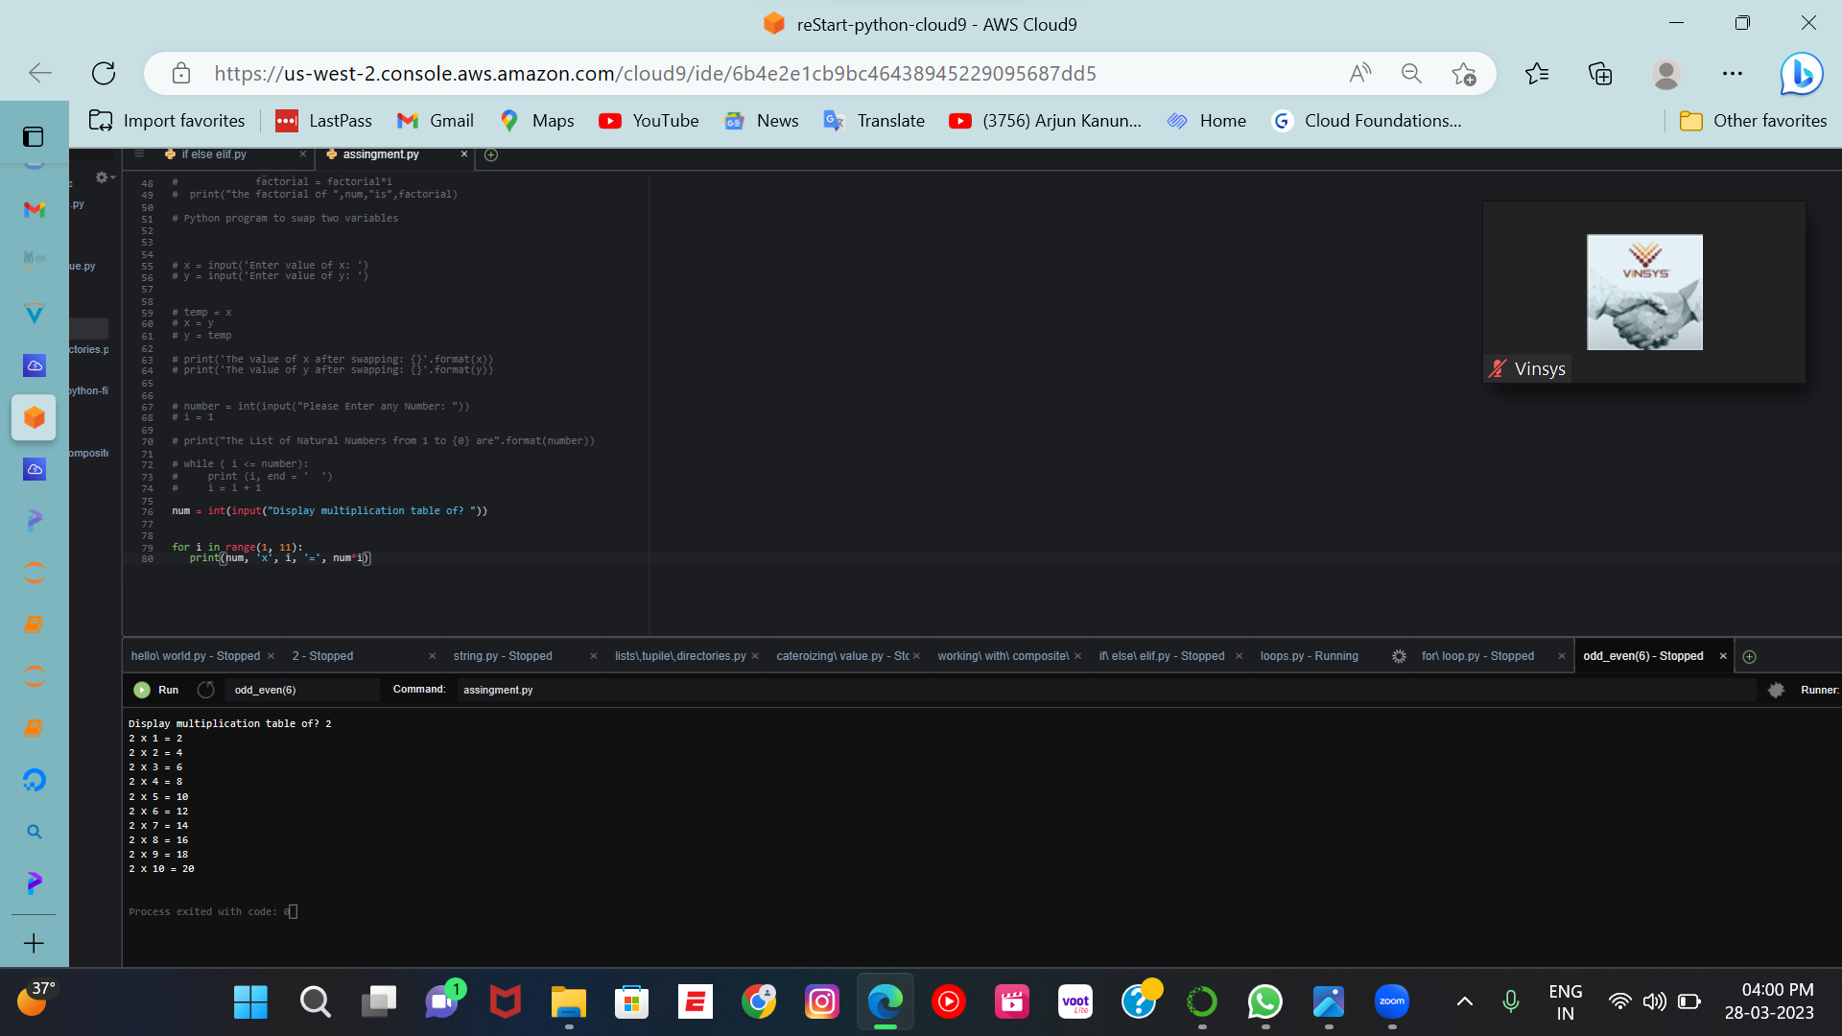
7.Multiplication of number using range

Slide 9
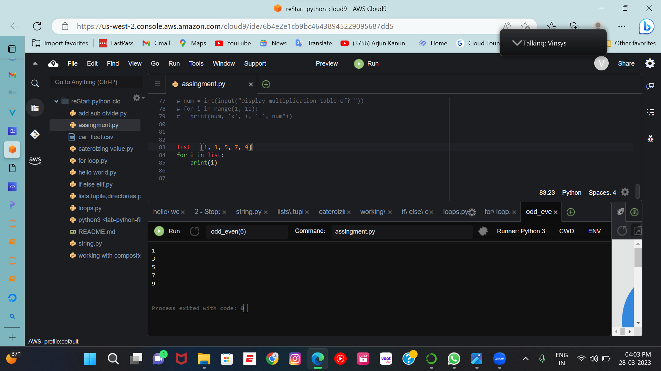
8.List of the no.

Slide 10
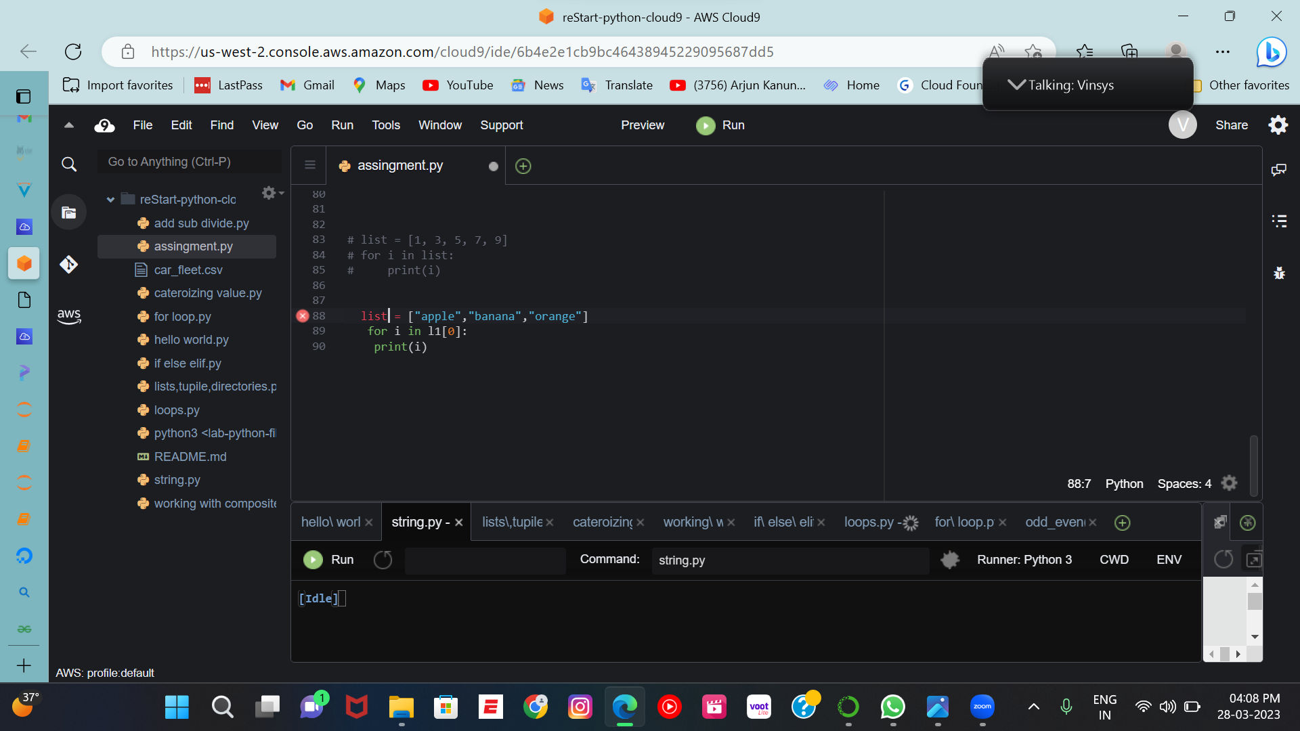
9.Finding the first letter of the no.

Slide 11
THE END

